Slide 1
Field-Replaceable Port Savers for FlexScan FS200, FS300, TS100
062021.0

Slide 2
Dirty / Damaged Connectors
Mating a dirty connector to a clean connector may contaminate or even damage the clean connector
Cleaning with tissue paper or a shirt may scratch the connector end-face
Once damaged, a connector cannot be repaired by cleaning
Damage in the core region increases loss and reflectance
Contamination outside the core region may keep end-faces apart resulting in excess loss and reflection
Ceramic ferrule end-face
To prevent damage to connector end-faces, always clean connectors before mating
125 μm cladding
8-9 μm single-mode core

Slide 3
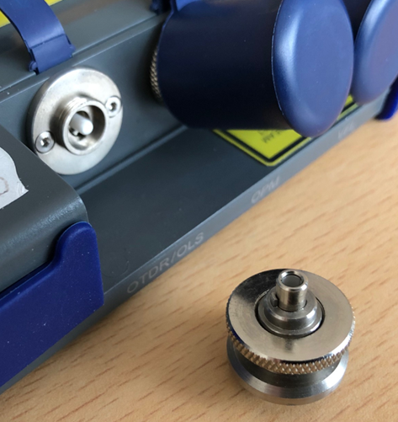
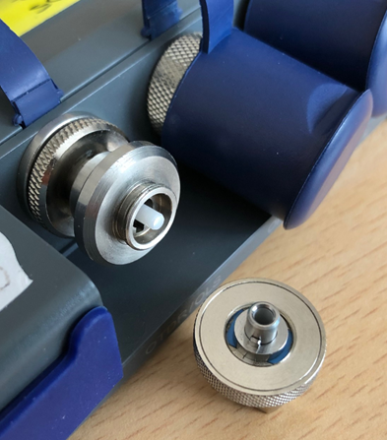
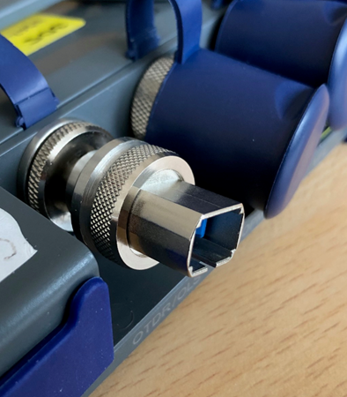
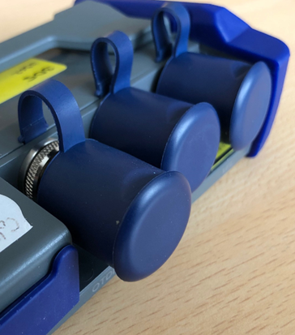
FlexScan Field-Replaceable Port Saver Connectors
Swap in field to convert OTDR port to UPC or APC
Replace in field if end-face damaged from connection to dirty or damaged launch cables or patch cords
Low-cost replacement eliminates costly and time-consuming factory repair
Accepts tool-free interchangeable SC, FC, LC and ST connector adapters
Dust cap can be installed with/without tool-free interchangeable adapter installed
Replaceable Connector
SC Adapter Installed
Captive Dust Cap
Interchangeable Adapter
Replaceable Connector
Avoid costly Test Set repairs: Install a field-replaceable connector!

Slide 4
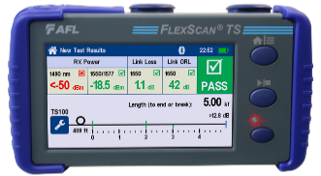
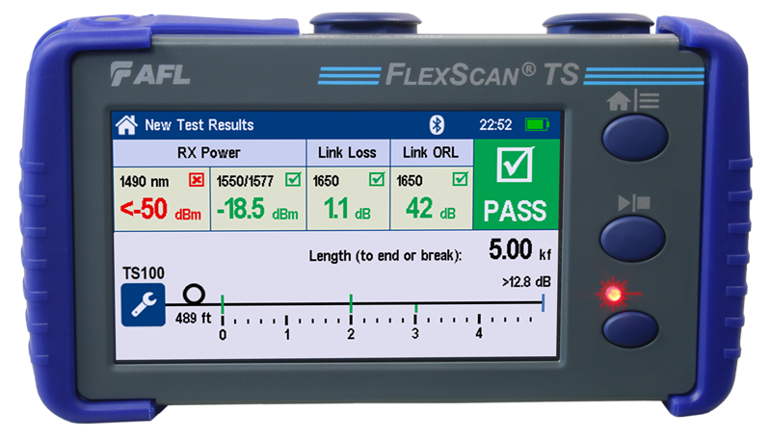
Port Saver Saves Time & Money
Traditional Connector Replacement
Connector Damaged
Ship OTDR for Repair (~2 days)
Repair & Recalibrate (~2 days)
Ship OTDR to User (~2 days)
Repaired OTDR Received
Interchangeable Adapter
Replaceable Connector
(APC or UPC)
OTDR Port
Port Saver Replacement
Connector Damaged
Replace Port Saver (2 minutes!)
OTDR Repaired

Slide 5
Selecting Field-Replaceable Port Saver Connectors
All FlexScan OTDRs / Troubleshooters are manufactured with a factory-installed 2.5 mm ferrule (male)
FS200 and FS300 SMF OTDR/OLS port: Factory-configured APC (recommended) or ultra-polished (UPC)
FS300 MMF OTDR/OLS port: Always Ultra-Polished (UPC)
TS100 OTS/OLS/OPM port: Always Angle-Polished (APC)
FlexScan OTDRs / Troubleshooters accept new field-replaceable connector:
Part Number | Description | Identifying Color Bands
 |  | FlexScan Port | Fiber Port
2900-58-0001MR | APC female (FlexScan-facing) to APC male (fiber-facing) | Green | Green
2900-58-0002MR | APC female (FlexScan-facing) to UPC male (fiber-facing) | Green | Blue
2900-58-0003MR | UPC female (FlexScan-facing) to APC male (fiber-facing) | Blue | Green
2900-58-0004MR | UPC female (FlexScan-facing) to APC male (fiber-facing) | Blue | Blue
Green band indicates female end is APC
Blue band indicates male ferrule is UPC
Male End
(Fiber-facing)
(Ferrule dust cap in place)
Female End
(FlexScan-facing)

Slide 6
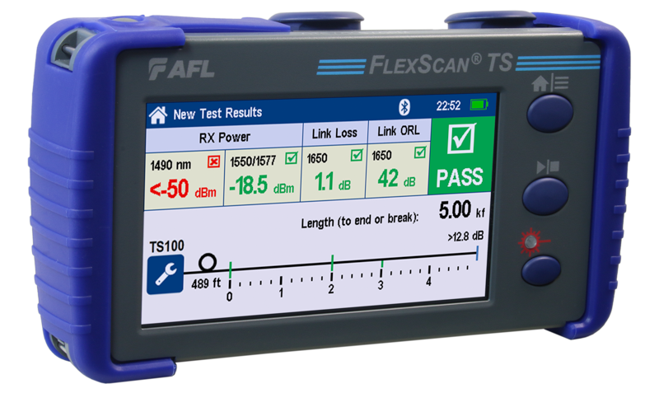
Port Savers adapt APC to UPC and Vice Versa
2900-58-0001MR
2900-58-0002MR
2900-58-0003MR
2900-58-0004MR
APC
UPC
APC
UPC
APC
APC
UPC
UPC
APC OTDR Ferrule (recommended)
UPC OTDR Ferrule (available)

Slide 7
Thank You!

